Slide 1
Object Oriented Programming Concepts Using C++ & Data Structures

Slide 2
Topics Covered
Introduction to algorithm
Analysis of Algorithms
Space complexity of algorithm
Time complexity of algorithm
Data Structures
Array
Stack (Array Implementation)
Queue (Array Implementation)

Slide 3
Introduction to Algorithm
Finite set of instructions that, if followed,accomplishes a particular task.
Algorithms tell the programmers how to code the program.
Step 1 − START ADD
Step 2 − get values of a & b
Step 3 − c ← a + b
Step 4 − display c
Step 5 − STOP

Slide 4
Characterstics of an Algorithm
Input : Zero or more quantities are externally supplied.
Output : At least one quantity is produced.
Definiteness : Each instruction is clear and unambiguous.
Finiteness : If we trace out the instructionsof an algorithm,then for all cases,the algorithm terminates after a finite numbero f steps.
Effectiveness : Every instruction must be very basic so that it can be carried out, in principle,by a person using only pencil and paper. It is not enough that each operation be definite as in criterion. it also must befeasible.

Slide 5
Analysis of Algorithms
Describes the efficiency of the algorithm in terms of the amount of the memory required to process the data and the processing time.
Complexity of an algorithm is analyzed in two perspectives: Time and Space.

Slide 6
Asymptotic Notations
Refers to defining the mathematical boundation/framing of its run-time performance
Usually, the time required by an algorithm falls under three types −
Best Case − Minimum time required for program execution.
Average Case − Average time required for program execution.
Worst Case − Maximum time required for program execution.

Slide 7
Asymptotic Notations
Following are the commonly used asymptotic notations to calculate the running time complexity of an algorithm.
Ο Notation
Ω Notation
θ Notation
Asymptotic analysis refers to computing the running time of any operation in mathematical units of computation.
For example, the running time of one operation is computed as f(n) and may be for another operation it is computed as g(n2).
This means the first operation running time will increase linearly with the increase in n and the running time of the second operation will increase exponentially when n increases.
Similarly, the running time of both operations will be nearly the same if n is significantly small.

Slide 8
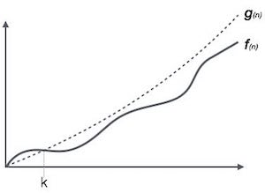
Big Oh Notation, Ο
The notation Ο(n) is the formal way to express the upper bound of an algorithm's running time. It measures the worst case time complexity or the longest amount of time an algorithm can possibly take to complete.
Ο(f(n)) = { g(n) : there exists c > 0 and n0 such that f(n) ≤ c.g(n) for all n > n0. }

Slide 9
Example : Big Oh Notation, Ο
Let us consider a given function, f(n)=4.n³+10.n²+5.n+1
Considering g(n)=n³,
f(n)⩽5.g(n) for all the values of n>2
Hence, the complexity of f(n) can be represented as O(g(n)), i.e. O(n³)

Slide 10
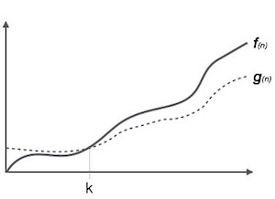
Omega Notation, Ω
The notation Ω(n) is the formal way to express the lower bound of an algorithm's running time. It measures the best case time complexity or the best amount of time an algorithm can possibly take to complete.
Ω(f(n)) ≥ { g(n) : there exists c > 0 and n0 such that g(n) ≤ c.f(n) for all n > n0. }

Slide 11
Example : Omega Notation, Ω
Let us consider a given function, f(n)=4.n³+10.n²+5.n+1.
Considering g(n)=n³, f(n)⩾4.g(n) for all the values of n>0.
Hence, the complexity of f(n) can be represented as Ω(g(n)), i.e. Ω(n³)

Slide 12
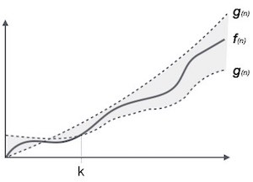
Theta Notation, θ
The notation θ(n) is the formal way to express both the lower bound and the upper bound of an algorithm's running time. It is represented as follows −
θ(f(n)) = { g(n) if and only if g(n) = Ο(f(n)) and g(n) = Ω(f(n)) for all n > n0. }

Slide 13
Example : Theta Notation, θ
Let us consider a given function, f(n)=4.n³+10.n²+5.n+1
Considering g(n)=n³, 4.g(n)⩽f(n)⩽5.g(n) for all the large values of n.
Hence, the complexity of f(n) can be represented as θ(g(n)), i.e. θ(n³).

Slide 14
Space Complexity
Space complexity is a function describing the amount of memory (space) an algorithm takes in terms of the amount of input to the algorithm
Space complexity is sometimes ignored because the space used is minimal and/or obvious, however sometimes it becomes as important issue as time complexity

Slide 15
Time Complexity
It’s a function describing the amount of time required to run an algorithm in terms of the size of the input. "
Time" can mean the number of memory accesses performed, the number of comparisons between integers, the number of times some inner loop is executed, or some other natural unit related to the amount of real time the algorithm will take.

Slide 16
Apriori and Apostiari Analysis
Apriori analysis means, analysis is performed prior to running it on a specific system.
This analysis is a stage where a function is defined using some theoretical model.
Hence, we determine the time and space complexity of an algorithm by just looking at the algorithm rather than running it on a particular system with a different memory, processor, and compiler.
Apostiari analysis of an algorithm means we perform analysis of an algorithm only after running it on a system.
It directly depends on the system and changes from system to system.

Slide 17
DS Overview & Why ?
Way of organizing data
Reduce the space and time complexities of different tasks.
High speed in processing
Efficiency of a program
Reusability and Abstraction

Slide 18
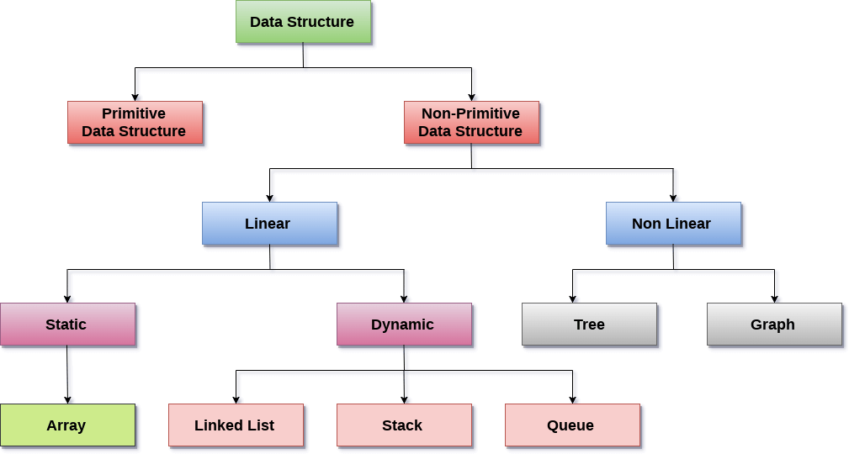
Data Structure Classification

Slide 19
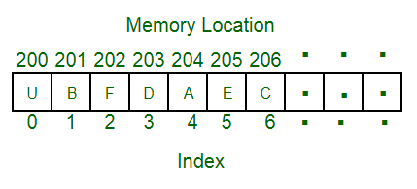
Array
Linear data structure
Elements are stored at contiguous memory locations.
Store multiple items of the same type together
Advantages :
Random access is allowed
Ease of insertion and in Accesss
Drawbacks:
Static memory allocation
Deletion requires Shifting of elements

Slide 20
Array - Accessing Element
accessed using an index number
first element is numbered 0, so that the indices in an array of 10 elements run from 0 to 9.
Complexity : O(1)
temp = myArray[3];

Slide 21
Array - Insertion of Element
Unsorted
Keep track of number of elements in array - nElts
Insert using index and Increment the tracking object
Complexity : O(1)
Sorted
Requires Searching for the postion
Shifting the elements to make the specfied postion to be vacant.
Complexity : O(N²)
arr[0] = 77
arr[nElts] = 12
nElts = nElts +1

Slide 22
Deletion of Element
Begins with a search for the specified item
When we find it, we move all the items with higher index values down one element to fill in the “hole” left by the deleted element
decrement nElems
for(j=0; j<nElems; j++) // look for it
if(arr[j]== eltToBeDeleted){
for(int k=j; k<nElems; k++) // higher ones down
arr[k] = arr[k+1];
nElems--; // decrement size
break;
}
}

Slide 23
Stack
Linear data structure
New element is added at one end and (top) an element is removed from that end only.
LIFO(Last In First Out) or FILO(First In Last Out).
Example : plates stacked over one another
Can be Implemented using Array or Linked List
Tracking Element : Top
Application :
Processing of subroutine calls and returns
reversing a string
backtracking - Eg :- Maze Game

Slide 24
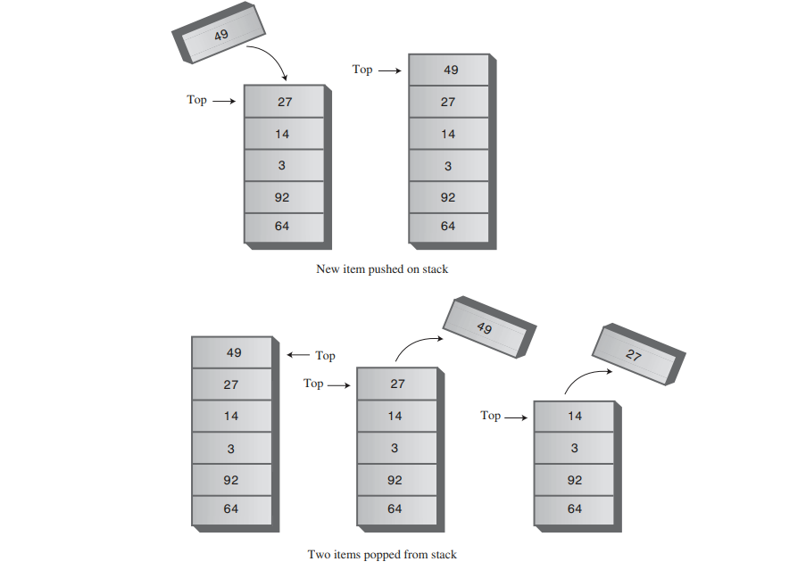
Stack Example

Slide 25
Implementation
class StackX
{
private int maxSize; // size of stack array
private long[] stackArray;
private int top; // top of stack
-------------------------------------------------------
public void StackX(int s) // constructor
{
maxSize = s; // set array size
stackArray = new long[maxSize]; // create array
top = -1; // no items yet
}
-------------------------------------------------------
public void push(long j) // put item on top of stack
{
stackArray[++top] = j; // increment top, insert item
}

Slide 26
Cont.
public long pop() // take item from top of stack
{
return stackArray[top--]; // access item, decrement top
}
-----------------------------------------------------
public long peek() // peek at top of stack
{
return stackArray[top];
}
-------------------------------------------------------
public boolean isEmpty() // true if stack is empty
{
return (top == -1);
}
-------------------------------------------------------
public boolean isFull() // true if stack is full
{
return (top == maxSize-1);
}
-------------------------------------------------------
} // end class StackX

Slide 27
Queue
Linear data structure
New element is added at one end and (rear) an element is removed other end (front).
First In First Out (FIFO)..
Example : Queue for Customer Service
Can be Implemented using Array or Linked List
Tracking Element : Rear and Front
Applications :
Time sharing system
Load Balancing system- Eg:- AWS-SQS, Hold for Tech Support
Print spooling,

Slide 28
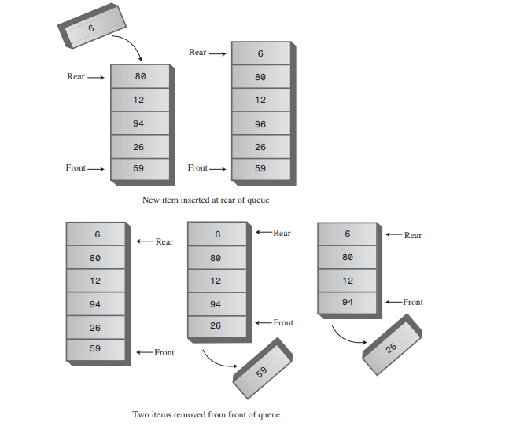
Queue Example

Slide 29
Implementation
class Queue
{
private int maxSize;
private long[] queArray;
private int front;
private int rear;
-----------------------------------------------------
public Queue(int s) // constructor
{
maxSize = s+1; // array is 1 cell larger
queArray = new long[maxSize]; // than requested
front = 0;
rear = -1;
}
-------------------------------------------------------
public void insert(long j) // put item at rear of queue
{
if(rear == maxSize-1)
rear = -1;
queArray[++rear] = j;
}

Slide 30
public long remove() // take item from front of queue
{
long temp = queArray[front++];
if(front == maxSize)
front = 0;
return temp;
}
------------------------------------------------------
public long peek() // peek at front of queue
{
return queArray[front];
}
------------------------------------------------------
public boolean isEmpty() // true if queue is empty
{
return(rear+1==front || (front+maxSize-1==rear) );
}
------------------------------------------------------
public boolean isFull() // true if queue is full
{
return (rear+2==front ||(front+maxSize-2==rear) );
}
} // end class Queue

